Slide 1


Simonpaolo Lopez
5/10/2024

Slide 2

Outline
Executive Summary
Introduction
Methodology
Results
Conclusion
Appendix

Slide 3
Executive Summary
Summary of methodologies
Data collection through API
Data collection with web scraping
Data wrangling
Exploratory Data Analysis with SQL
Exploratory Data Analysis with Data Visualization
Interactive Visual Analytics with Folium
Machine Learning Prediction
Summary of all results
Exploratory Data Analysis Result
Interactive Analytics in screenshots
Predictive analytics result

Slide 4
Introduction
Project background and context
SpaceX advertises Falcon 9 rocket launches at a cost of $62 million, significantly lower than the $165 million typically charged by other providers. This reduced cost is largely due to SpaceX’s ability to reuse the first stage of the rocket. Therefore, if we can predict whether the first stage will successfully land, we can estimate the cost of a launch. This insight can be valuable for companies bidding against SpaceX for rocket launch contracts. The aim of this project is to develop a machine learning pipeline that predicts whether the first stage of a rocket will land successfully.
Problems you want to find answers
What factors influence the success of a rocket landing?
What operating conditions are required to ensure a successful landing program?
How do various features interact to affect the success rate of a landing?

Slide 5

Section 1

Slide 6
Methodology
Executive Summary
Data collection methodology:
Data was collected using SpaceX API and web scaped from Wikipedia
Perform data wrangling
One-hot encoding was applied to categorical features
Perform exploratory data analysis (EDA) using visualization and SQL
Perform interactive visual analytics using Folium and Plotly Dash
Perform predictive analysis using classification models
How to build, tune, evaluate classification models

Slide 7
Data Collection
Describe how data sets were collected.
Data was collected using a GET request from the SpaceX API.
The API response was decoded into JSON, then converted into a pandas DataFrame using .json_normalize().
Web scraping was performed using BeautifulSoup to extract Falcon 9 launch records from Wikipedia.
The goal was to parse the HTML table of launch records and convert it into a pandas DataFrame for analysis.
Data cleaning involved checking for and filling in missing values.

Slide 8
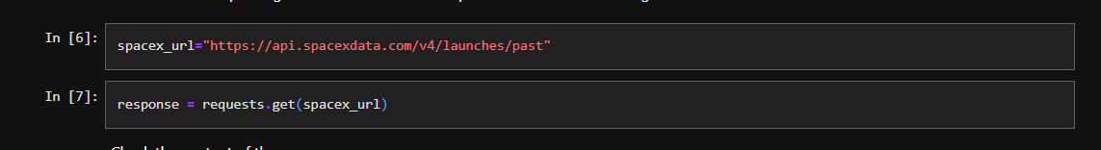
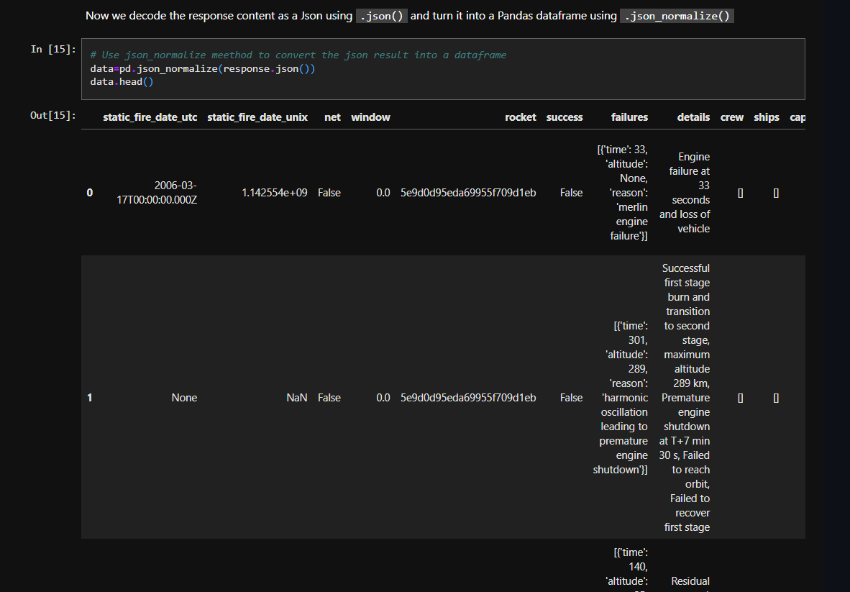
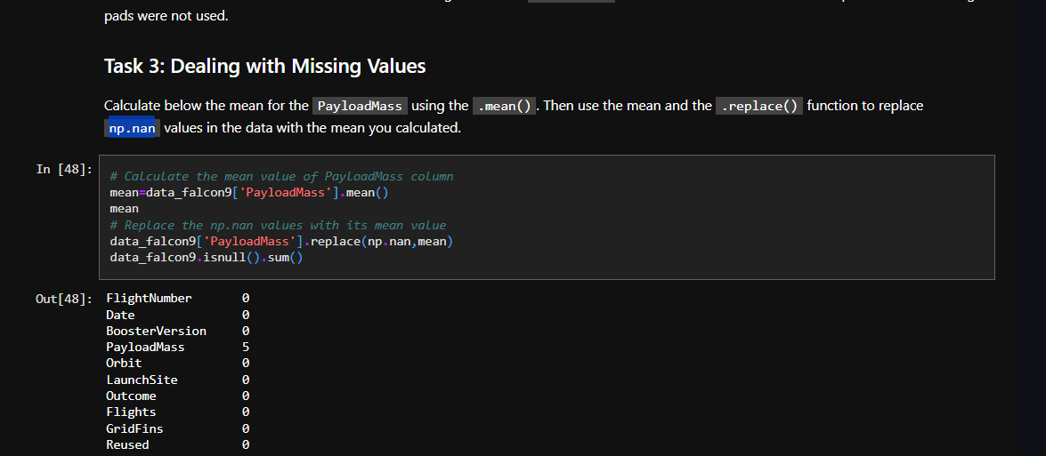
Data Collection – SpaceX API
I used the get request to the SpaceX API to collect data, clean the requested data and did some basic data wrangling and formatting
The link to the notebook is
https://github.com/simoneloop/IBM-Data-Science-Capstone-SpaceX/blob/main/jupyter-labs-spacex-data-collection-api.ipynb

Slide 9
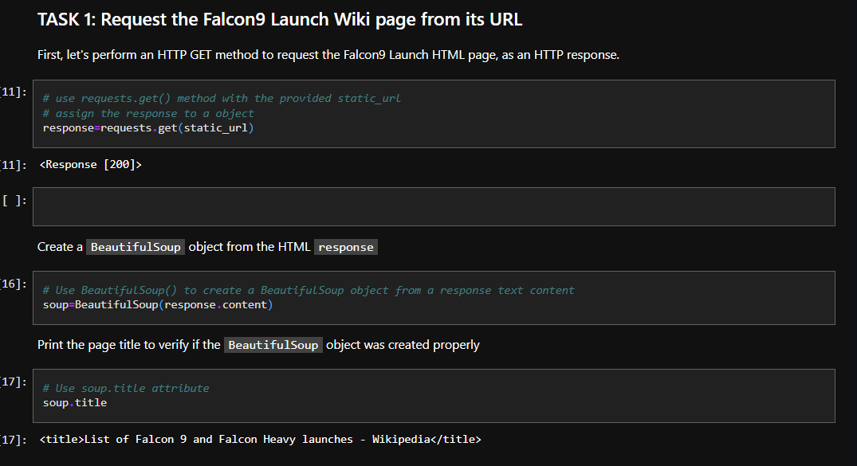
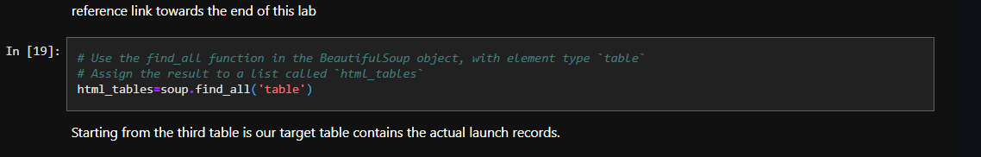
Data Collection - Scraping
I applied web scraping to Falcon 9 launch records with beautifulSoup
Parsed the table and converted it into pandas dataframe
The link to the notebook is
https://github.com/simoneloop/IBM-Data-Science-Capstone-SpaceX/blob/main/jupyter-labs-webscraping.ipynb

Slide 10
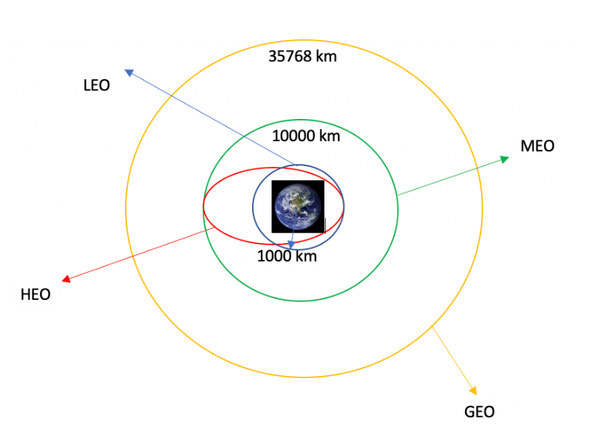
Data Wrangling
Performed exploratory data analysis and determined the training labels.
Calculated the number of launches at each site, and the number and occurrence of each orbits
Created landing outcome label from outcome column and exported the results to csv
The link to the notebook is
https://github.com/simoneloop/IBM-Data-Science-Capstone-SpaceX/blob/main/labs-jupyter-spacex-Data%20wrangling-v2.ipynb

Slide 11
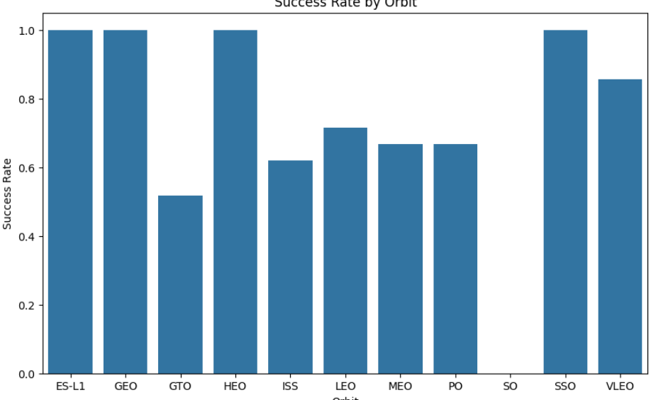
EDA with Data Visualization
Explored the data by visualizing the relationship between flight number and launch site, payload and launch site, success rate of each orbit type, flight number and orbit type, the launch success yearly trend.
The link to the notebook is
https://github.com/simoneloop/IBM-Data-Science-Capstone-SpaceX/blob/main/edadataviz.ipynb

Slide 12
EDA with SQL
Loaded the SpaceX dataset into a PostgreSQL database without leaving the jupyter notebook.
Applied EDA with SQL to get insight from the data. Wrote queries to find out:
The names of unique launch sites in the space mission.
The total payload mass carried by booster launched by NASA
The average payload mass carried by booster version F9 v1.1
The total number of successful and failure mission outcomes
The failed landing outcomes in drone ship, their booster version and launch site names
The link to the notebook is
https://github.com/simoneloop/IBM-Data-Science-Capstone-SpaceX/blob/main/EDA%20with%20SQL.ipynb

Slide 13
Build an Interactive Map with Folium
Mapping Launch Sites: All launch sites were marked on a folium map, and map objects like markers, circles, and lines were added to represent the success or failure of launches at each site.
Classifying Launch Outcomes: Launch outcomes (success or failure) were assigned numeric classes: 0 for failure and 1 for success.
Success Rate Analysis: Color-labeled marker clusters were used to identify launch sites with relatively high success rates.
Proximity Calculation: The distances between launch sites and nearby infrastructures such as railways, highways, and coastlines were calculated. Questions were answered, such as whether launch sites are close to these features or maintain certain distances from cities.
The link to the notebook is
https://github.com/simoneloop/IBM-Data-Science-Capstone-SpaceX/blob/main/lab_jupyter_launch_site_location_with_folium.ipynb

Slide 14
Build a Dashboard with Plotly Dash
The image outlines additional steps in the project:
Interactive Dashboard: An interactive dashboard was created using Plotly Dash.
Pie Charts: Pie charts were plotted to display the total number of launches by specific sites.
Scatter Graph: A scatter plot was created to show the relationship between launch outcomes and payload mass (in kilograms) for different booster versions.
Notebook Link: A link to the project's notebook is provided: https://github.com/simoneloop/IBM-Data-Science-Capstone-SpaceX/blob/main/app.py

Slide 15
Predictive Analysis (Classification)
Data Loading and Preparation: Data was loaded using NumPy and Pandas, then transformed and split into training and testing sets.
Model Building and Hyperparameter Tuning: Different machine learning models were built and hyperparameters were optimized using GridSearchCV.
Evaluation Metric: Accuracy was used as the evaluation metric. Feature engineering and algorithm tuning were applied to improve the model's performance.
Best Model Selection: The best-performing classification model was identified.
Notebook Link: The link to the notebook with the machine learning work is https://github.com/simoneloop/IBM-Data-Science-Capstone-SpaceX/blob/main/SpaceX_Machine%20Learning%20Prediction_Part_5.ipynb

Slide 16
Results
Exploratory data analysis results
Interactive analytics demo in screenshots
Predictive analysis results

Slide 17

Section 2

Slide 18
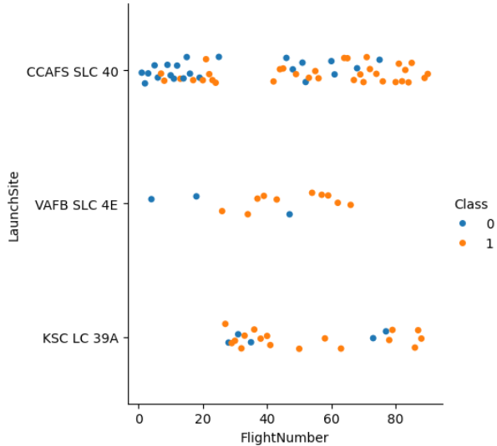
Flight Number vs. Launch Site
Show a scatter plot of Flight Number vs. Launch Site
The larger the flight amount at a launch site, the greater the success rate at a launch site.

Slide 19
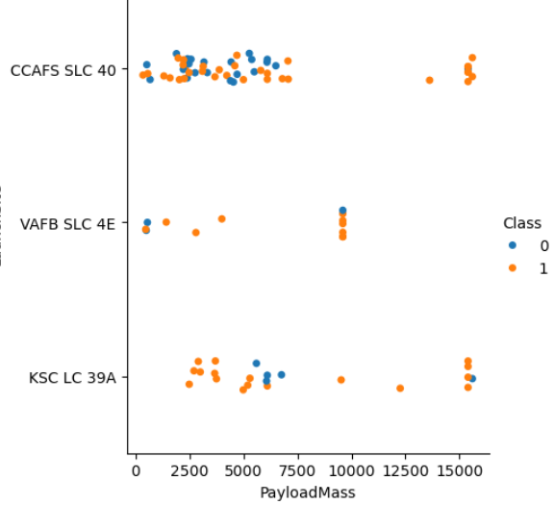
Payload vs. Launch Site
Show a scatter plot of Payload vs. Launch Site
The greater the payload mass for launchsite CCAFS SLC 40 the higher the success rate for the rocket

Slide 20
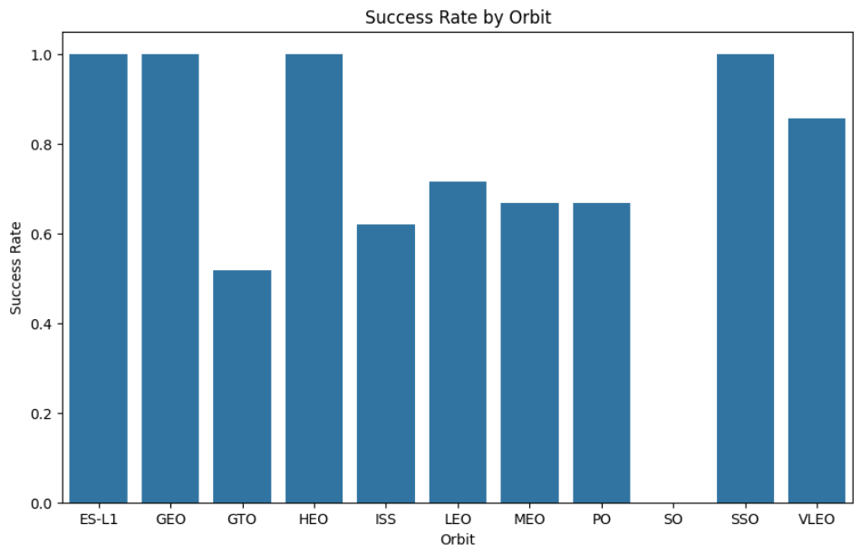
Success Rate vs. Orbit Type
Show a bar chart for the success rate of each orbit type
From the plot we can see that ES-L1, GEO, HEO, SSO, VLEO had the most success rate

Slide 21
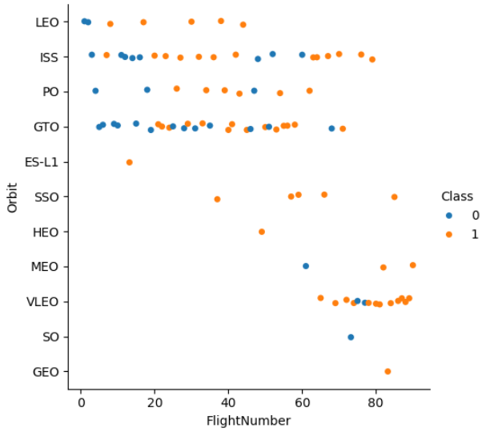
Flight Number vs. Orbit Type
Show a scatter point of Flight number vs. Orbit type
The plot shows the flight number vs orbit type. We can observe that in the LEO orbit, success is related to the number of flights whereas in the GTO orbit there is no relationship

Slide 22
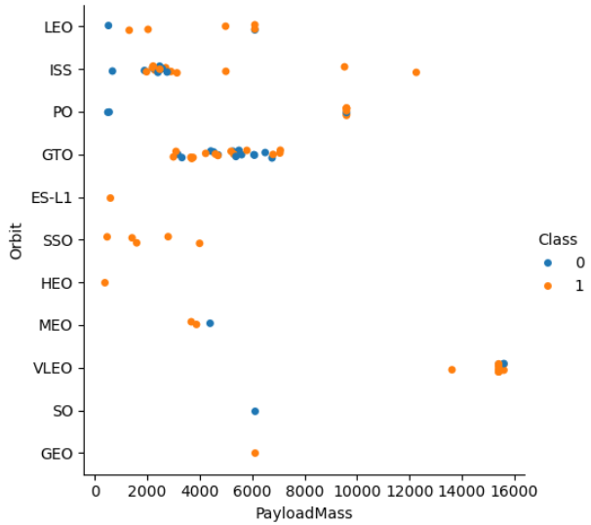
Payload vs. Orbit Type
Show a scatter point of payload vs. orbit type
We can observe that with heavy payloads, the successful landing are more for PO, LEO and ISS orbits

Slide 23
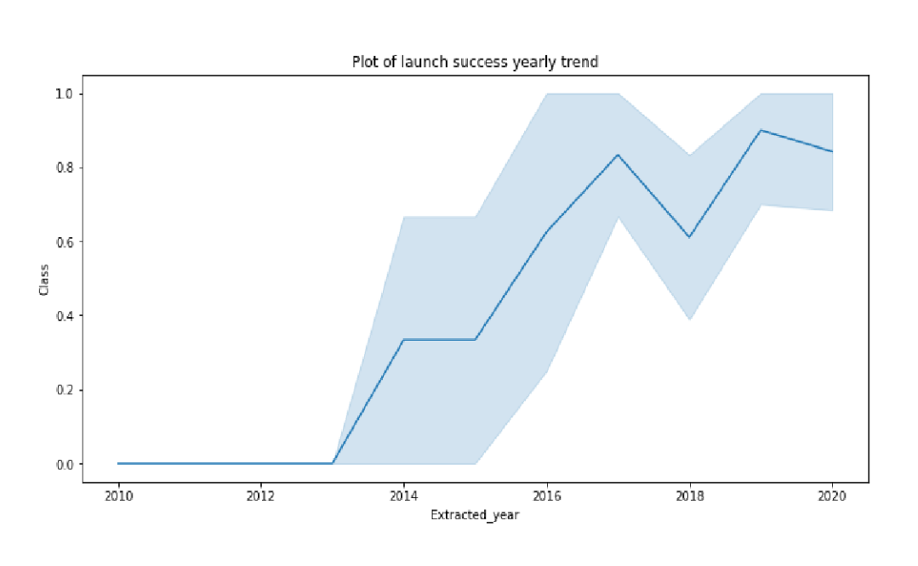
Launch Success Yearly Trend
We can observe that success rate since 2013 kept on increasing till 2020

Slide 24
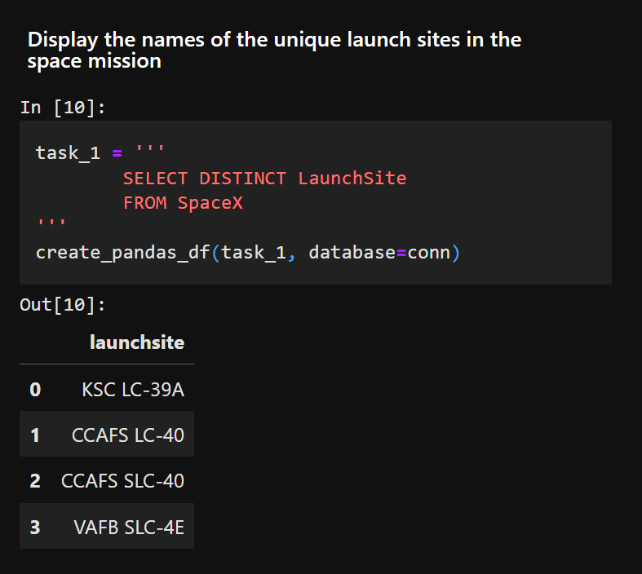
All Launch Site Names
Find the names of the unique launch sites
I used Distinct to display unique launch site

Slide 25
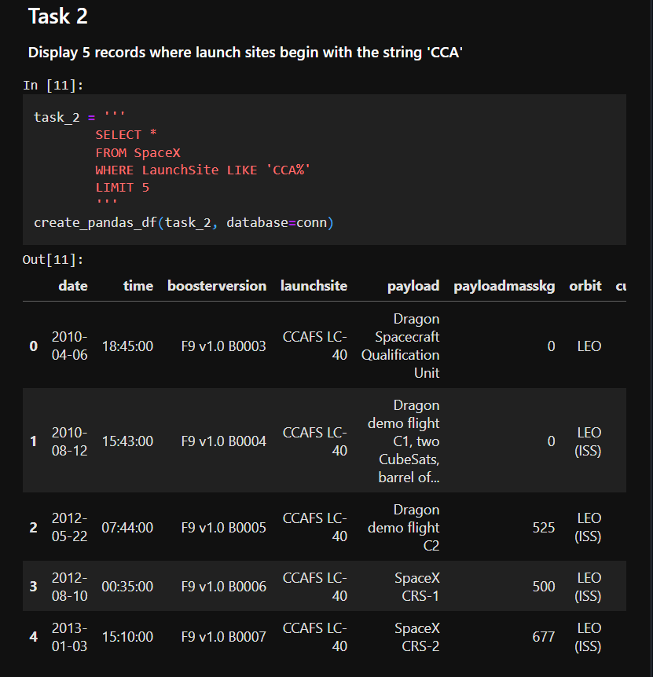
Launch Site Names Begin with 'CCA'
Find 5 records where launch sites begin with `CCA`
Used “Like” and “%” to find pattern that start with CCA and limited results to 5

Slide 26
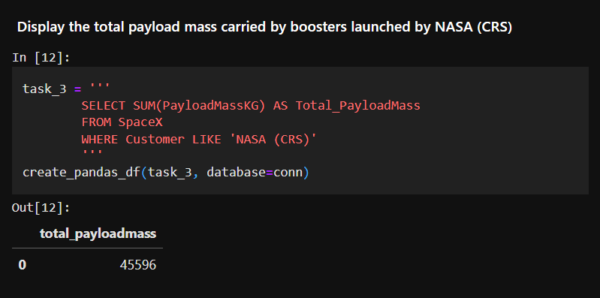
Total Payload Mass
Calculate the total payload carried by boosters from NASA
I used “SUM” keyword to aggregate and sum the column “PAYLOADMASSKG”

Slide 27
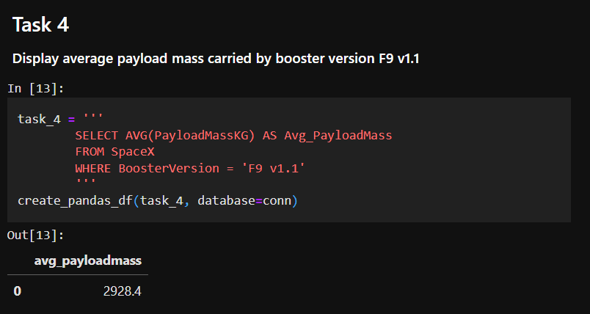
Average Payload Mass by F9 v1.1
Calculate the average payload mass carried by booster version F9 v1.1
Like the task before but with average and only where BoosterVersion was “F9 v1.1”

Slide 28
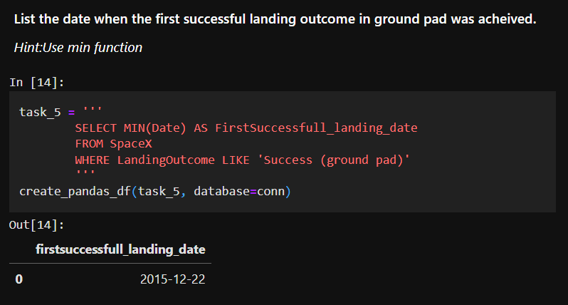
First Successful Ground Landing Date
Find the dates of the first successful landing outcome on ground pad
To Find the first I used min function like the minimum of dates

Slide 29
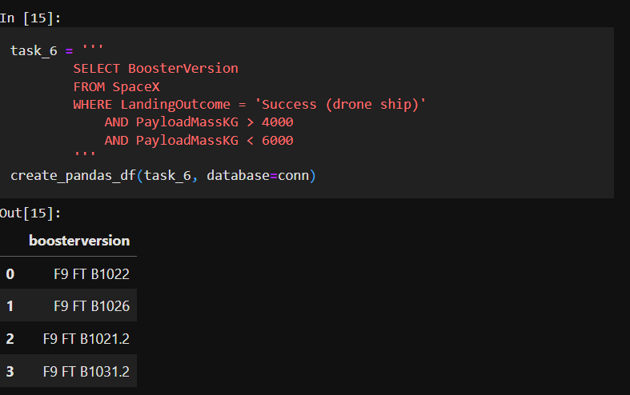
Successful Drone Ship Landing with Payload between 4000 and 6000
List the names of boosters which have successfully landed on drone ship and had payload mass greater than 4000 but less than 6000
I could use the keywords “between” too

Slide 30
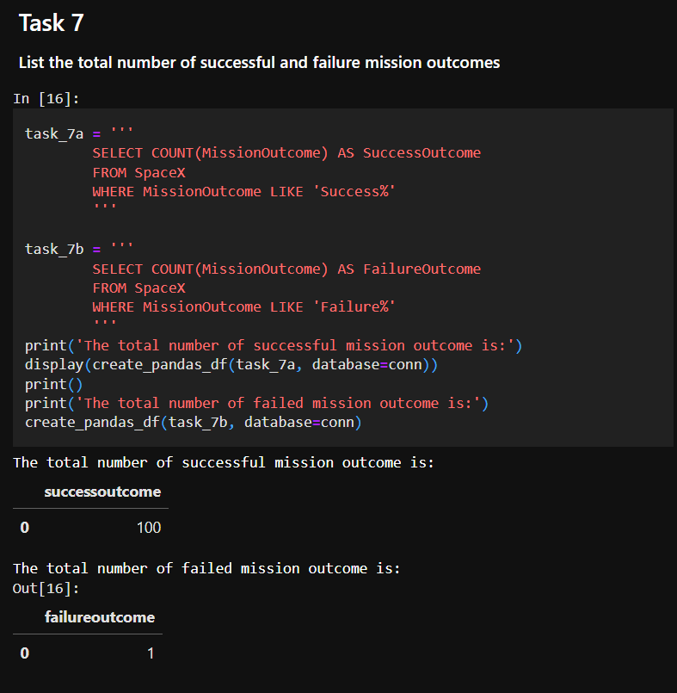
Total Number of Successful and Failure Mission Outcomes
Calculate the total number of successful and failure mission outcomes

Slide 31
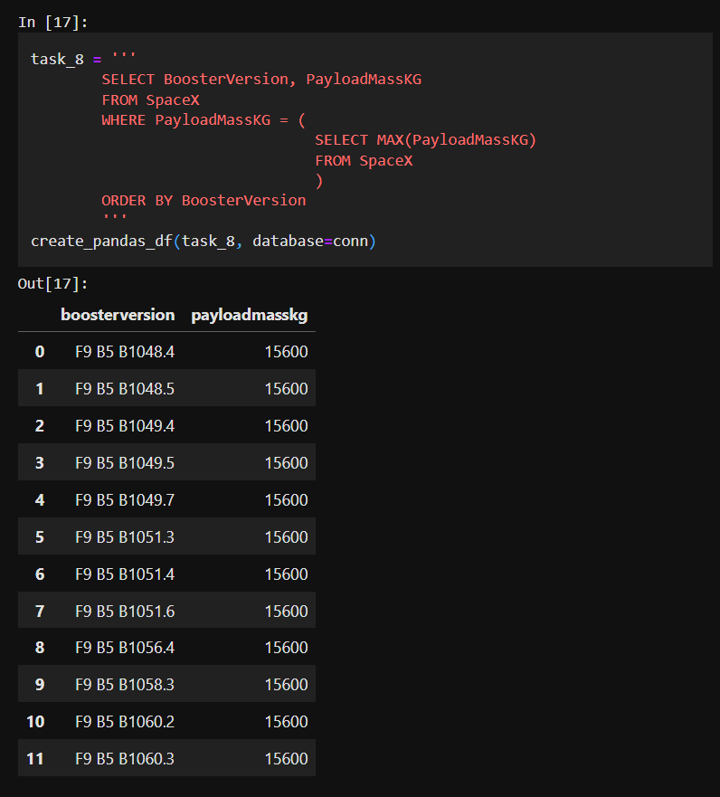
Boosters Carried Maximum Payload
List the names of the booster which have carried the maximum payload mass
With the keyword “Order by” was easy to order by payload mass

Slide 32
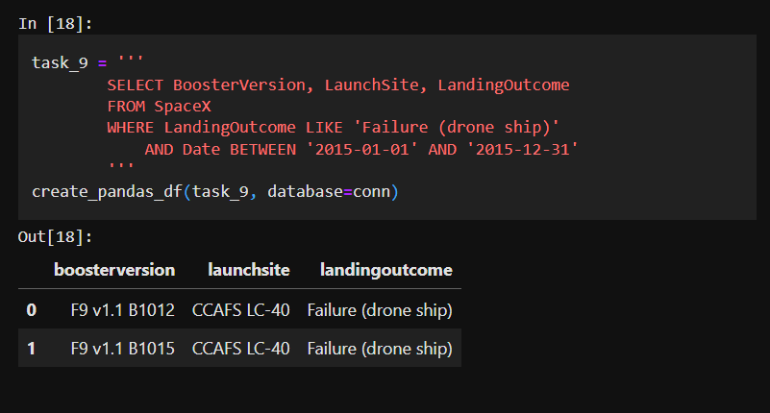
2015 Launch Records
List the failed landing_outcomes in drone ship, their booster versions, and launch site names for in year 2015

Slide 33
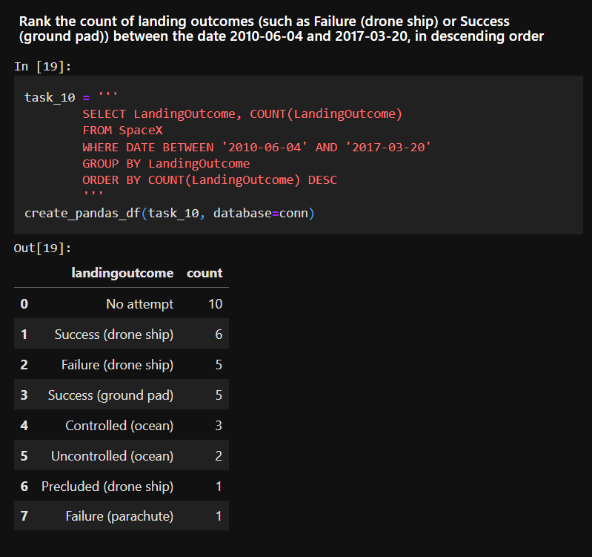
Rank Landing Outcomes Between 2010-06-04 and 2017-03-20
We selected Landing outcomes and the COUNT of landing outcomes from the data and used the WHERE clause to filter for landing outcomes BETWEEN2010-06-04 to 2010-03-20.
We applied the GROUP BY clause to group the landing outcomes and the ORDER BY clause to order the grouped landing outcome in descending order

Slide 34

Section 3

Slide 35
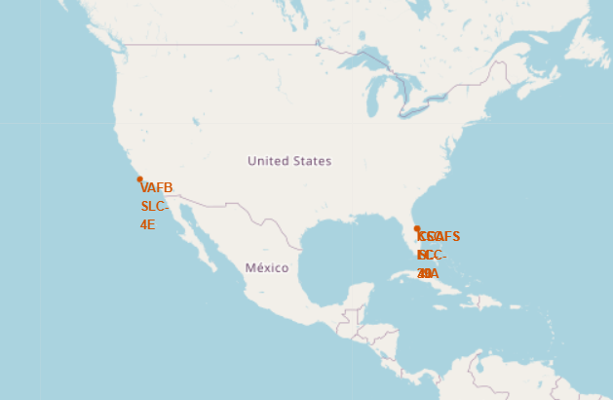
All launch sites global map markers
SpaceX launch site are in the united states of america coasts. Florida and California

Slide 36
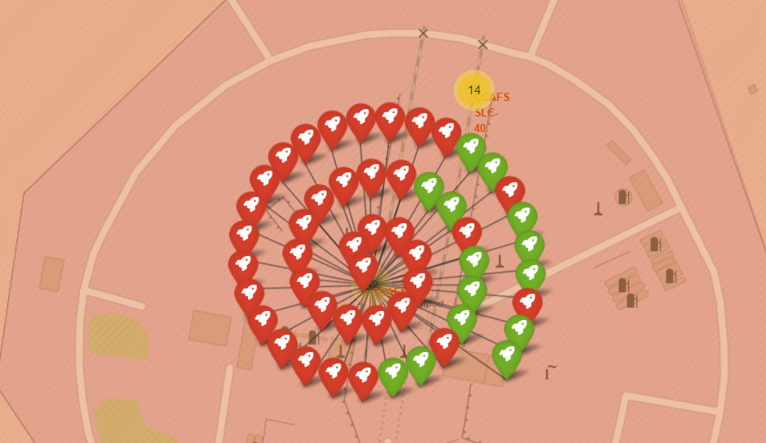
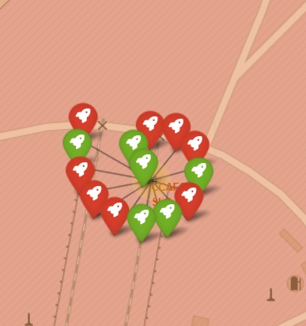
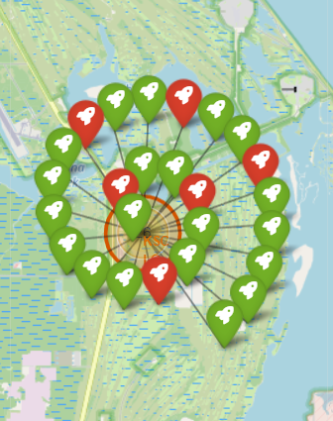
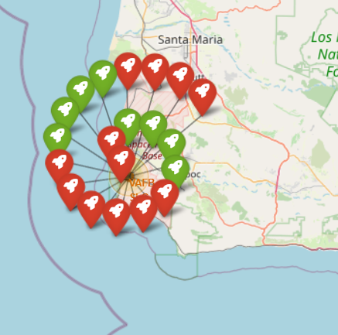
Markers showing launch sites with color labels

Slide 37
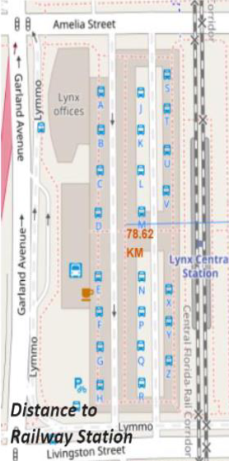
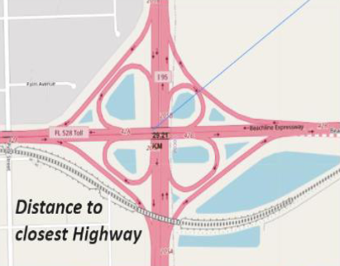
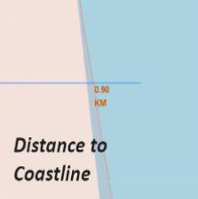
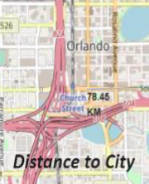
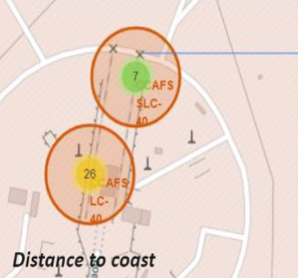
Launch Site distance to landmarks

Slide 38

Section 4

Slide 39
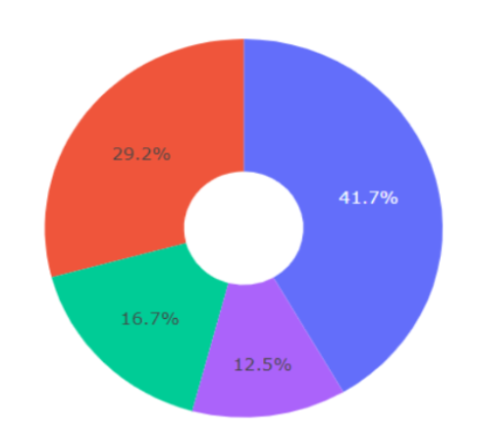
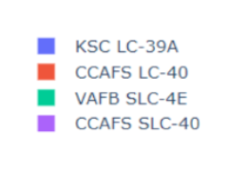
Pie chart showing the success percentage achieved by each launch site
KSC LC-39° had the most successful launches from all the sites

Slide 40
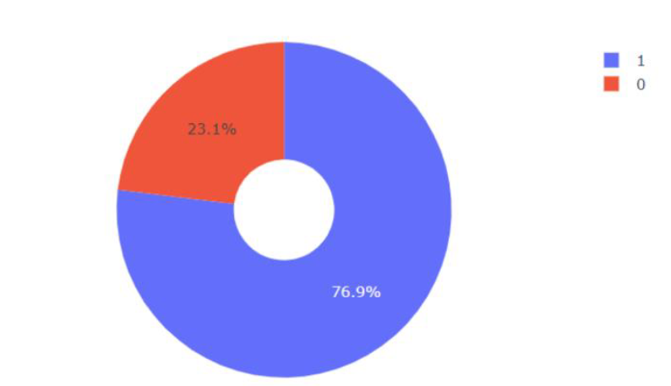
Pie chart showing the Launch site with the highest launch success ratio
KSC LC-39A achieved a 76.9% success rate while getting a 23.1% failure rate

Slide 41
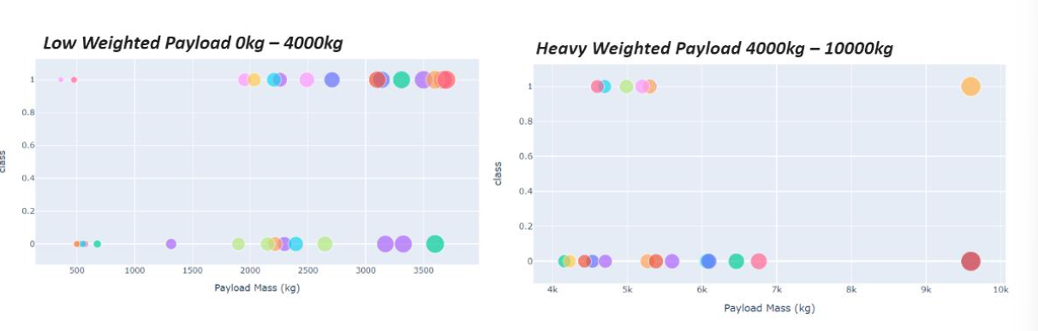
Scatter plot of Payload vs Launch Outcome for all sites, with differentpayload selected in the range slider41
The success rate for low weighted payloads is higher than the heavy weighted payloads

Slide 42

Section 5

Slide 43
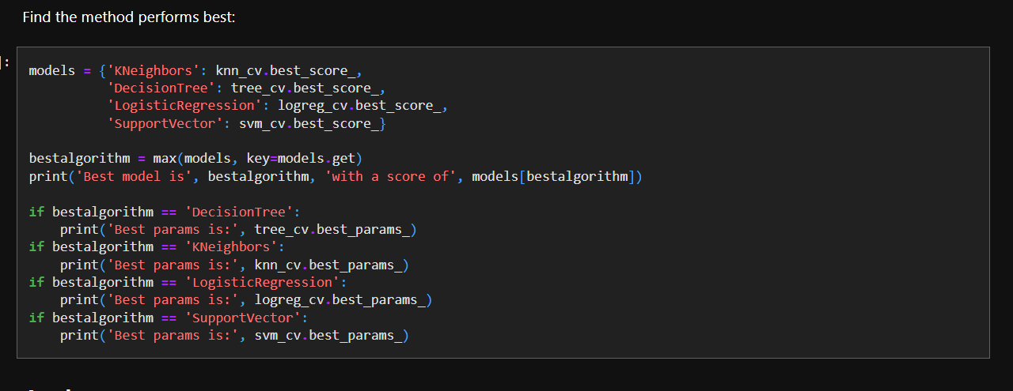
Classification Accuracy

Slide 44
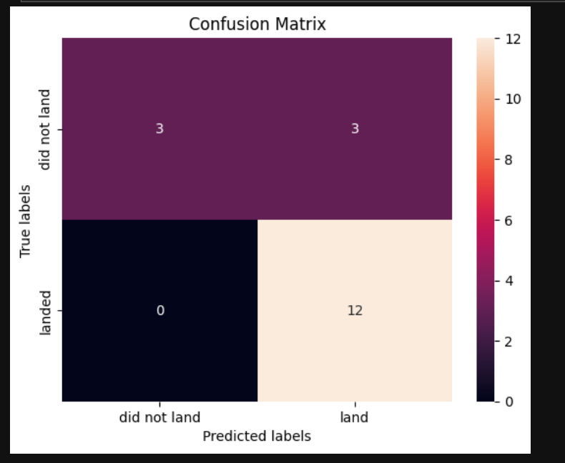
Confusion Matrix
The confusion matrix for the decision treeclassifier shows that the classifier candistinguish between the different classes.The major problem is the false positives .i.e.,unsuccessful landing marked as successfullanding by the classifier.

Slide 45
Conclusions
We can conclude that:
The larger the flight amount at a launch site, the greater the success rate at a launchsite.
Launch success rate started to increase in 2013 till 2020.
Orbits ES-L1, GEO, HEO, SSO, VLEO had the most success rate.
KSC LC-39A had the most successful launches of any sites.
The Decision tree classifier is the best machine learning algorithm for this task.Conclusions

Slide 46


